Slide 1
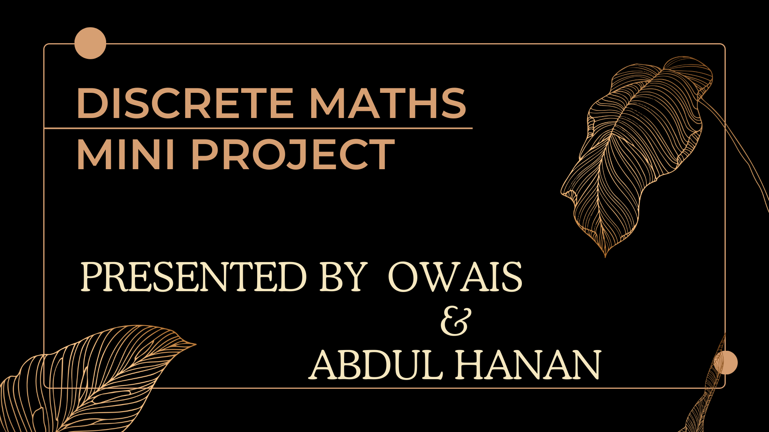
Presented By: Muhammad Owais & Abdul Hanan
Presented By: Abdul Hanan & Muhammad Owais

Slide 2


Slide 3
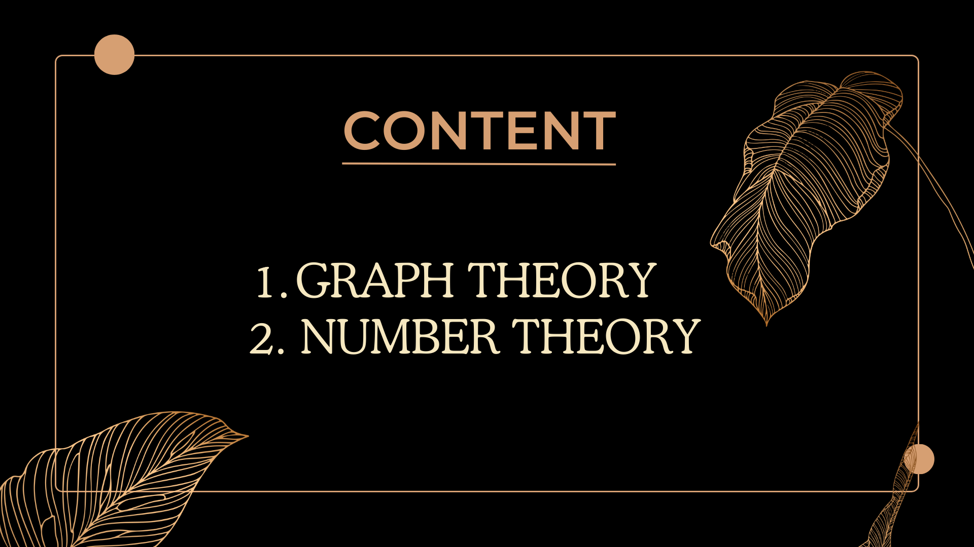

Slide 4

Graph Theory:
Graph Theory
Explore the interesting field of graph theory, where we study how things are connected. This has cool uses in social networks, finding the best paths for things like deliveries, and even figuring out strategies for games and puzzles!
Explore the interesting field of graph theory, where we study how things are connected. This has cool uses in social networks, finding the best paths for things like deliveries, and even figuring out strategies for games and puzzles!

Slide 5
Individual Contribution & Project Planning
Individual Contribution
Project Planning
I successfully completed the project independently, thereby demonstrating my proficiency and unwavering commitment. This experience has not only honed my ability to excel as an individual contributor but has also fortified my capacity to achieve outstanding results in a team-oriented environment.
In project planning, I divided the project into 4 parts:
Number Theory
Graph Theory
Making PowerPoint
Making Documentation
I studied from different websites and seniors, and then, I implemented my knowledge to perform the tasks. I performed these tasks in C++.

Slide 6
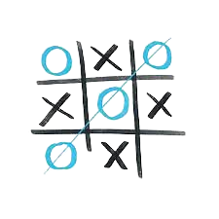
Tic Tac Toe
1
Type of graph
Tic Tac Toe is considered a directed graph because the moves in the game have a specific direction—they are made by individual players in a sequential order.
2
Achieve
3
Avoid
Strategically place your symbols to form a horizontal, vertical, or diagonal line of three to achieve victory. Control the center and corners to maximize winning opportunities.
Prevent the opponent from forming winning combinations by blocking their potential lines. Be cautious of moves that could lead to the opponent's victory and adapt to counter their strategy.

Slide 7
Tic Tac Toe
Generalization:
When we make Tic-Tac-Toe boards larger, like 4x4 or 5x5, it makes the graph more complex. Each possible board setup becomes a node, and legal moves are represented by edges. Studying these graphs helps us figure out winning strategies and understand how complex the game can get.

Slide 8
Tic Tac Toe
Nodes (Vertices):
Each node in the graph corresponds to a unique configuration of Xs and Os on the 3x3 grid. The initial node represents the empty board, and terminal nodes represent game outcomes (win, loss, or draw).
Edges (Directed):
Directed edges connect nodes to represent legal moves. For example, if a player places their symbol in a certain cell, there is a directed edge from the current board state to the resulting state after the move.
Depth:
The depth of the graph represents the number of moves made in the game. Since Tic Tac Toe has a maximum of nine moves, the graph has a finite depth.
Terminal Nodes:
Terminal nodes at the end of branches represent game outcomes, indicating a win, loss, or draw. These nodes have no outgoing edges.
Connected Components:
The graph is fully connected, meaning there is a path (sequence of legal moves) between any two nodes. This reflects the fact that players can reach any board configuration from the initial state through a series of legal moves.

Slide 9
Tic Tac Toe
Objective of Graphic representation:
Representing Tic Tac Toe as a graph facilitates strategic analysis using algorithms like minimax, enabling the identification of optimal moves. This graph-based approach serves as a teaching tool for graph theory concepts and allows for evaluating the game's complexity through algorithmic exploration. It provides a structured framework for understanding and developing algorithms that enhance decision-making in Tic Tac Toe.

Slide 10
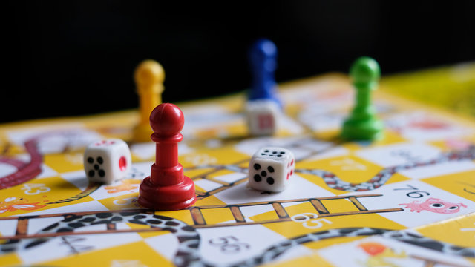
Analysis of game using Game theory
Game Analysis: Snakes and Ladder
Snake and Ladder is a luck-driven board game where players progress or regress based on dice rolls. Although strategic decisions are limited, the game's simplicity and element of surprise make it a timeless, family-friendly pastime, balancing chance and light strategy for an entertaining experience.

Slide 11
Analysis of game using Game theory
Graph Representation in Snakes and Ladder: The Snakes and Ladders board features numbered squares with arrows representing ladder climbs and snake descents, creating a dynamic gameplay of dice-driven advancement and setbacks.
Edges and Vertices in Snakes and Ladder Graph:
In Snakes and Ladders, the vertices are the numbered squares on the board, and the edges are the arrows depicting movement facilitated by ladders and snakes between these positions. The game progresses through transitions along these edges based on dice rolls.
Graph Theory in Winning and Losing:
In Snakes and Ladders, players navigate a graph of numbered squares connected by ladders and snakes, aiming to reach the final square to win or facing setbacks that may lead to a loss. The game's outcome is dictated by their positions on the graph.

Slide 12
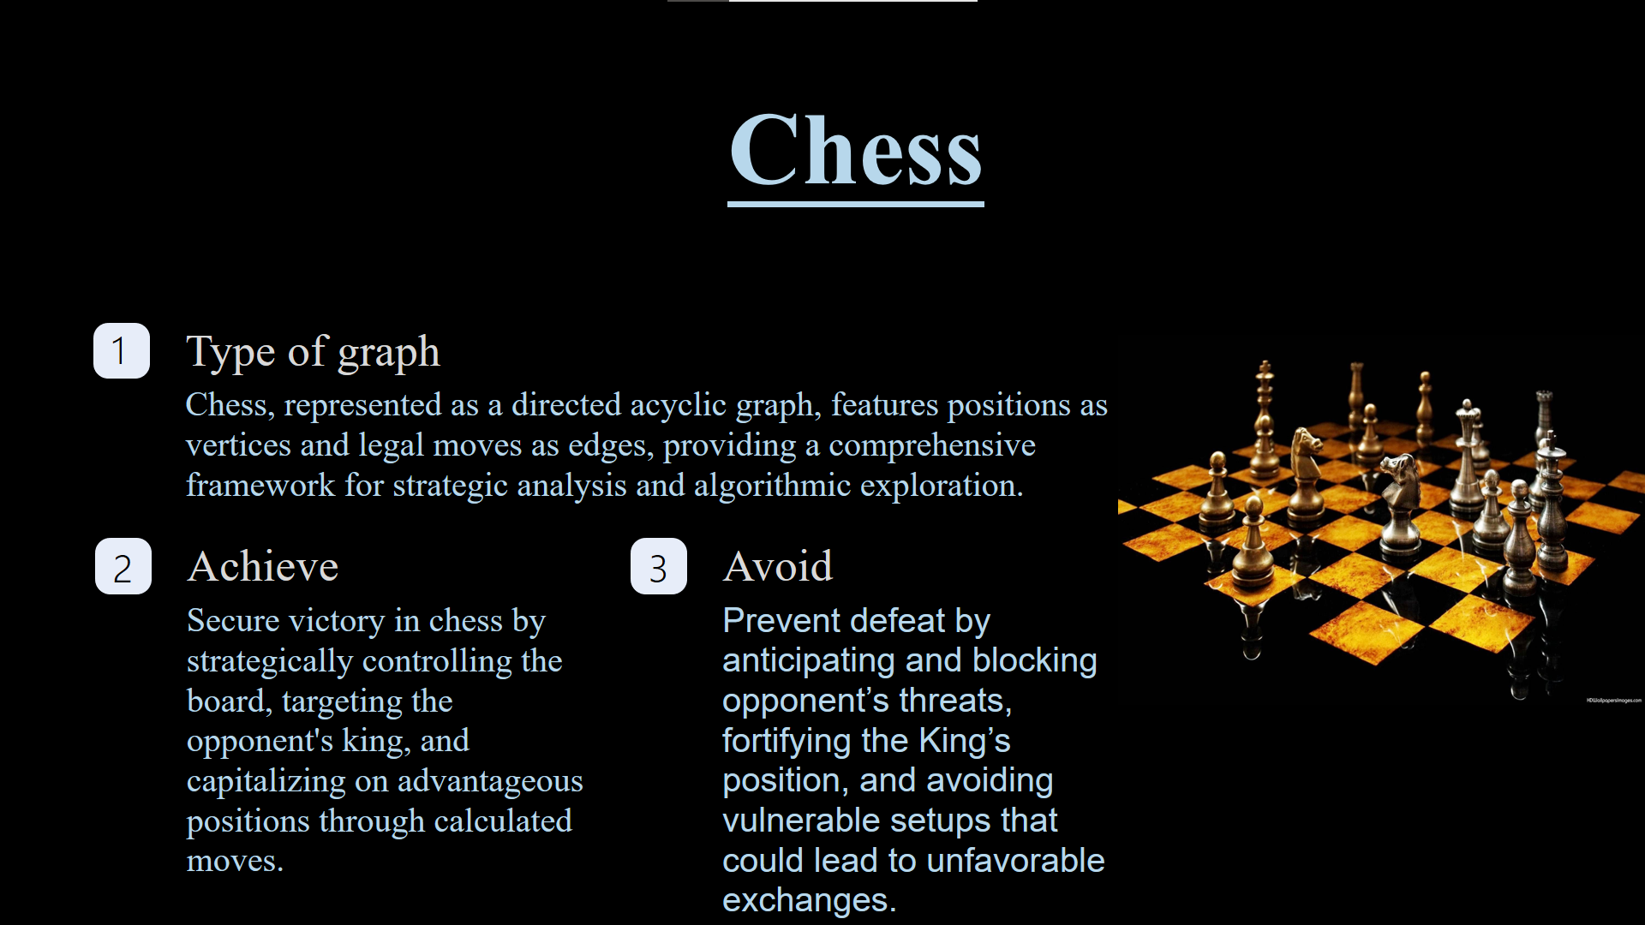

Slide 13
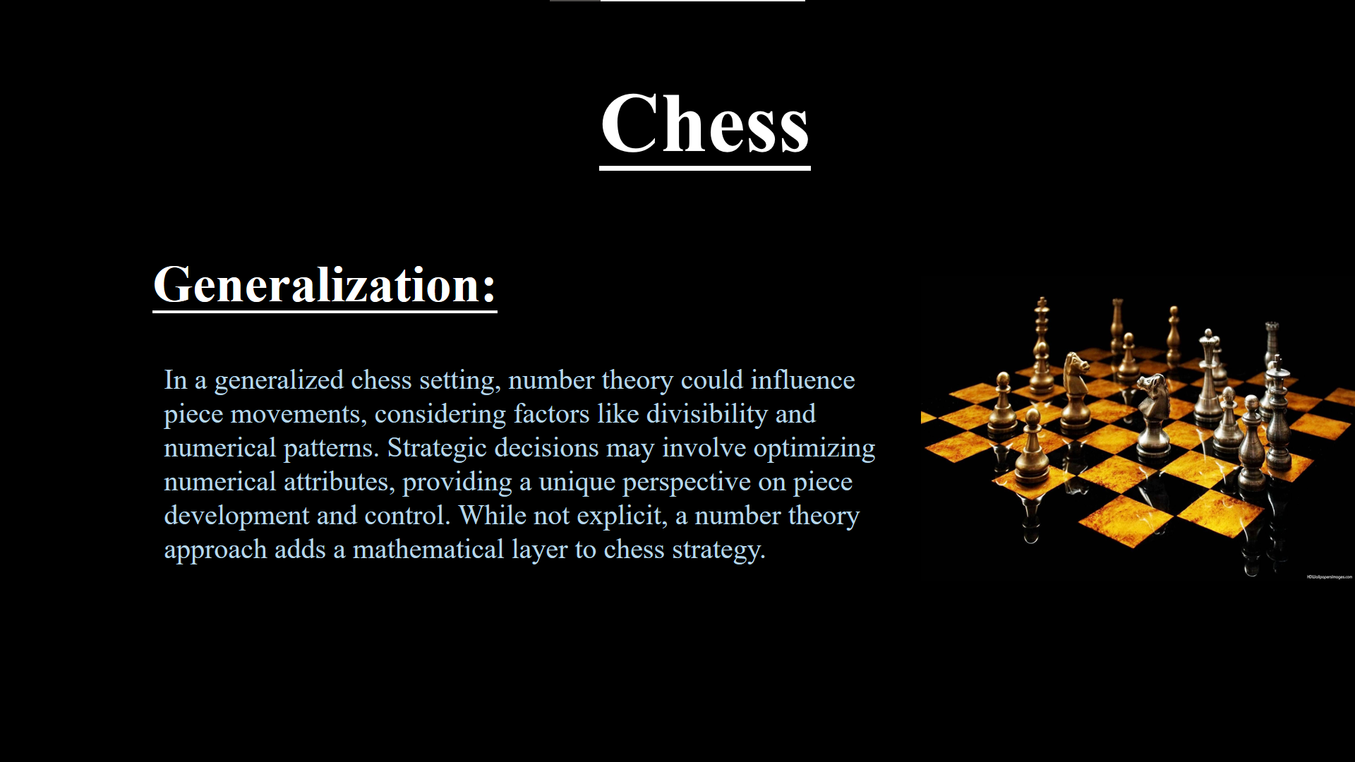

Slide 14
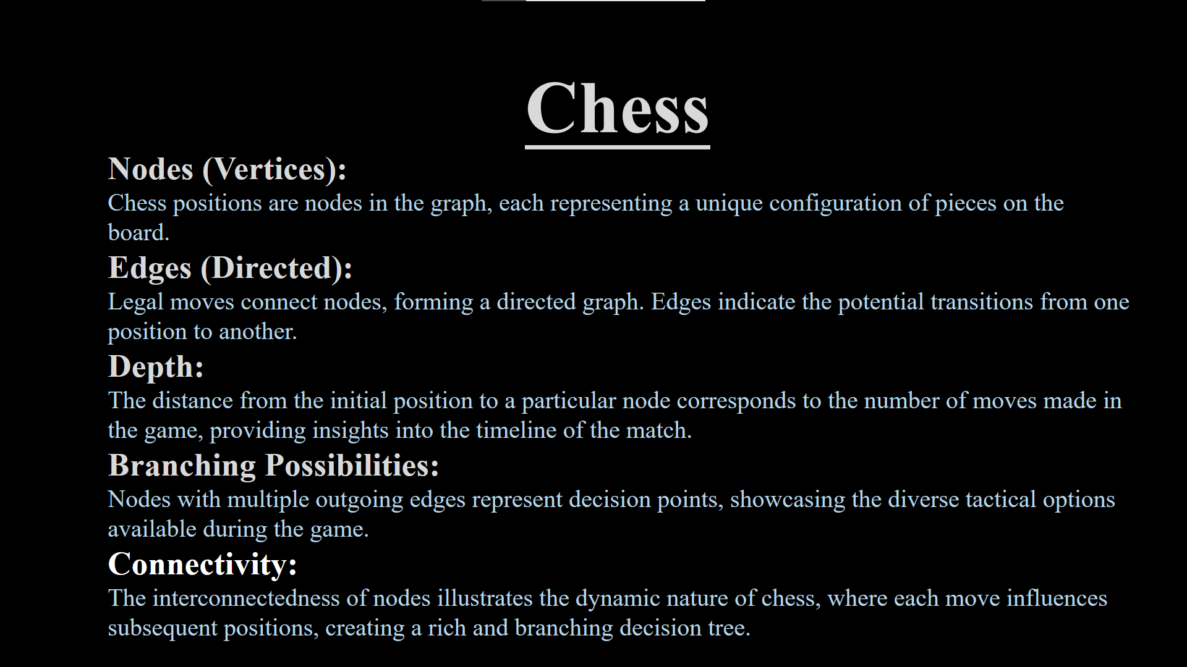

Slide 15
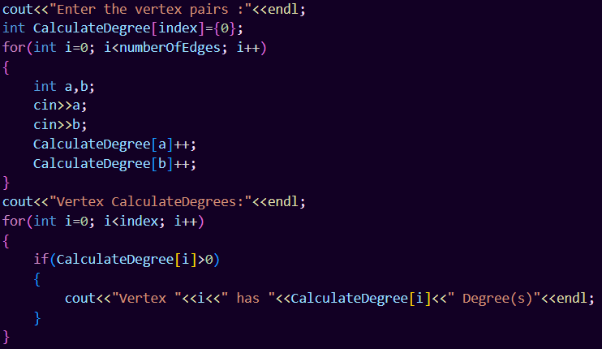
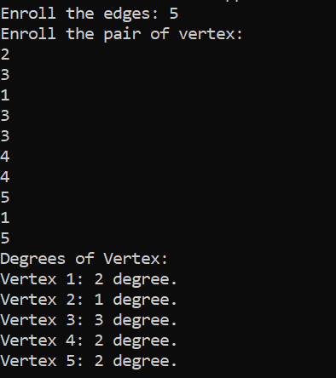
Coding Problems
Problem 1: Undirected Graph degrees

Slide 16
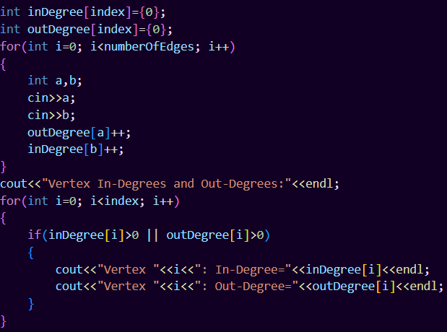
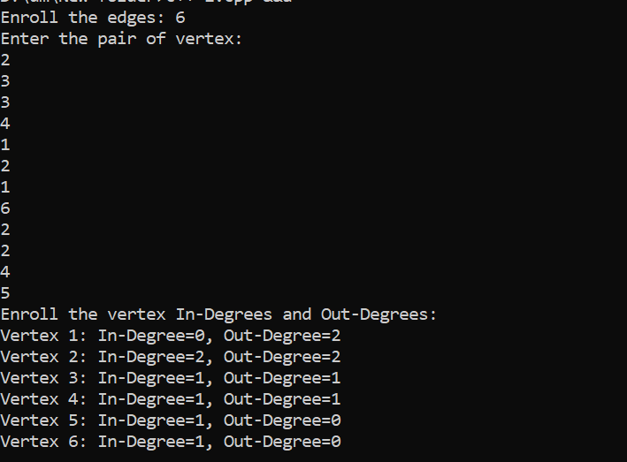
Coding Problems
Problem 2: Directed Graph degrees

Slide 17
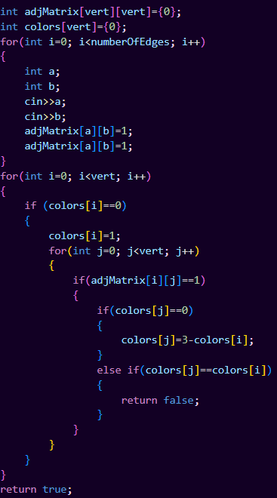
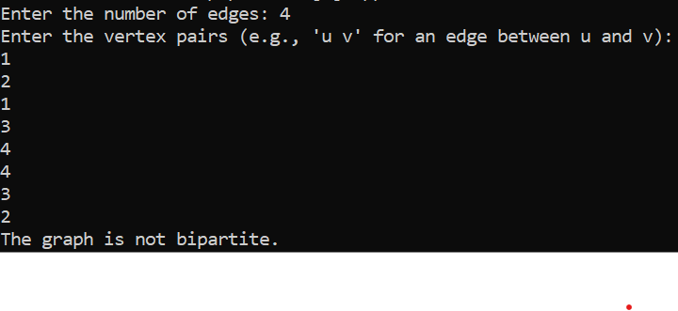
Coding Problems
Problem 3: Check Bipartite

Slide 18
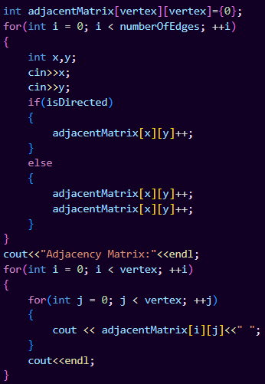
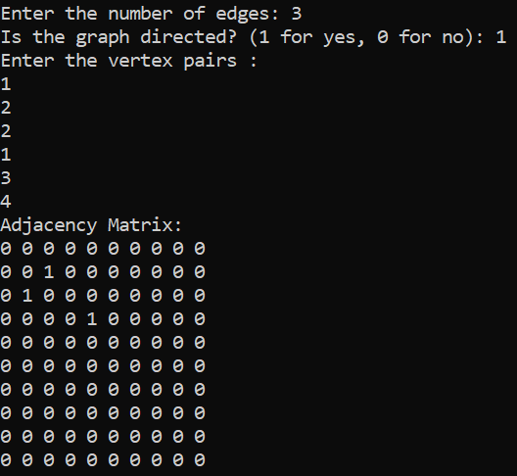
Coding Problems
Problem 4: Adjacency Matrix Creation

Slide 19
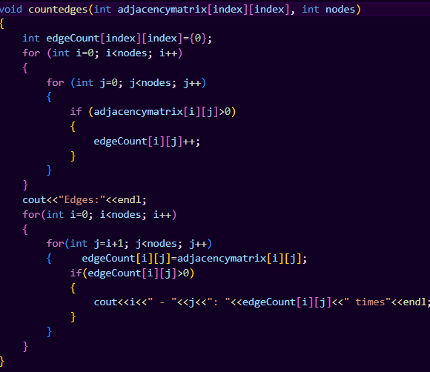
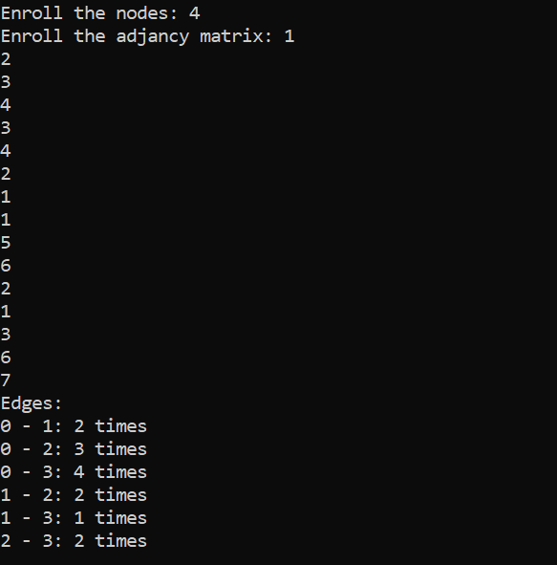
Coding Problems
Problem 5: Undirected Graph degrees

Slide 20
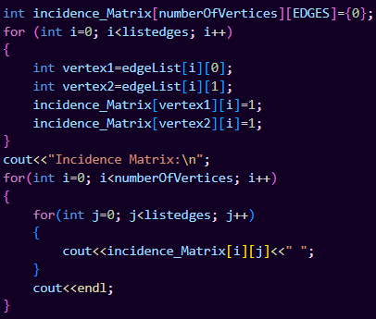
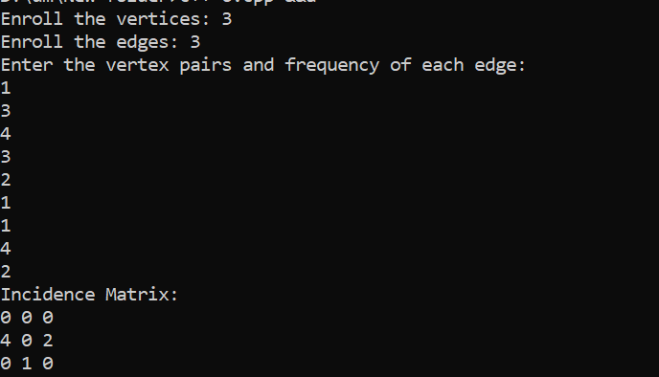
Coding Problems
Problem 6: Incidence Matrix Construction

Slide 21
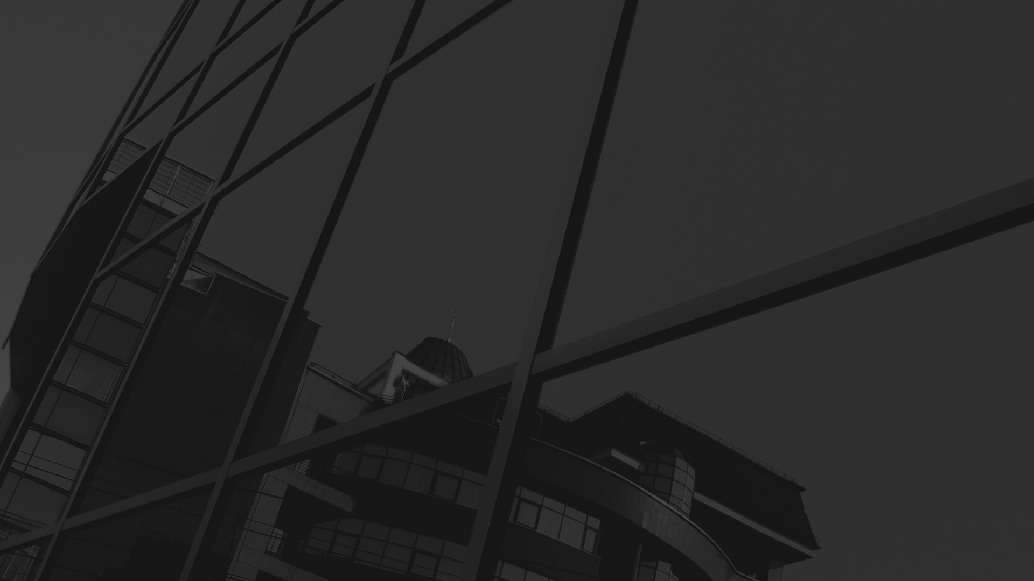
Conclusion:
Graph theory, a potent mathematical discipline, reveals intricate connections in social networks, routing optimization, and game models. Its capacity to represent and analyze complex systems enriches our comprehension of diverse phenomena, establishing it as a pivotal tool across various domains.

